Slide 1
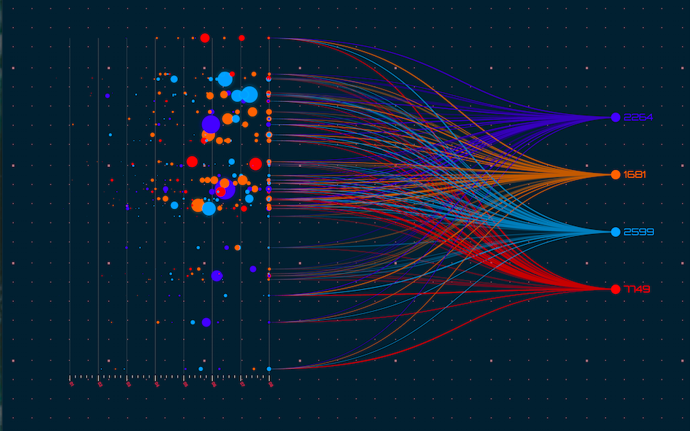
Data Visualization
Presented by :
Lipika Sharma

Slide 2
Introduction
Data visualization is the graphical representation of information and data. By using visual elements like charts, graphs, and maps, data visualization tools provide an accessible way to see and understand trends, outliers, and patterns in data.

Slide 3

Explain

Slide 4
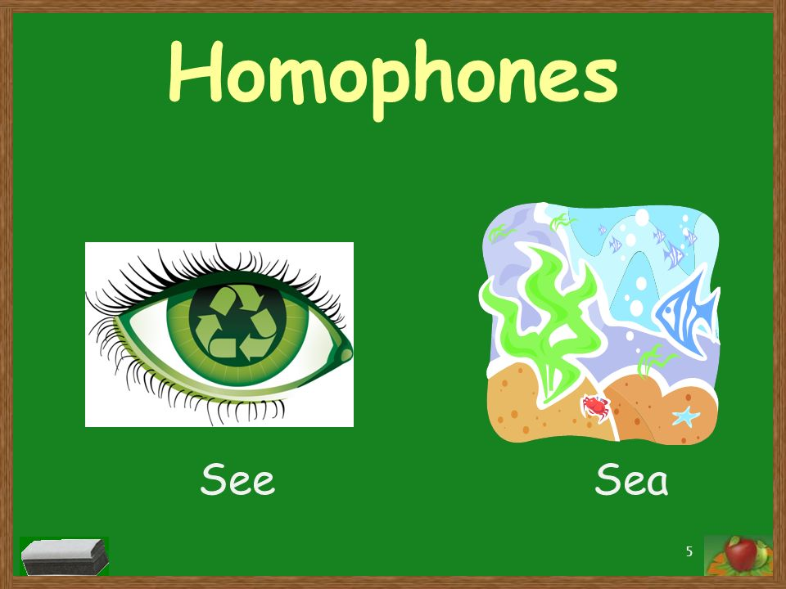
Explain

Slide 5


Perception

Slide 6
How to Analyze
Day to Day Life - Spreadsheets
Programmatic Access - Python
Advanced and Dynamic Effect - Tableau

Slide 7
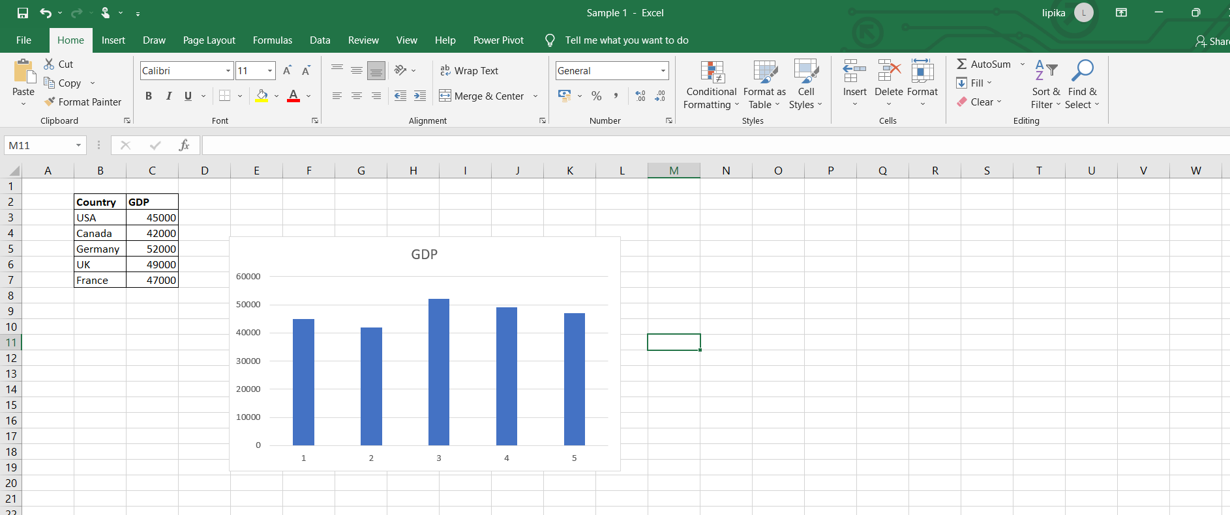
Country GDP USA 45000 Canada 42000 Germany 52000 UK 49000 France 47000 Spreadsheets

Slide 8
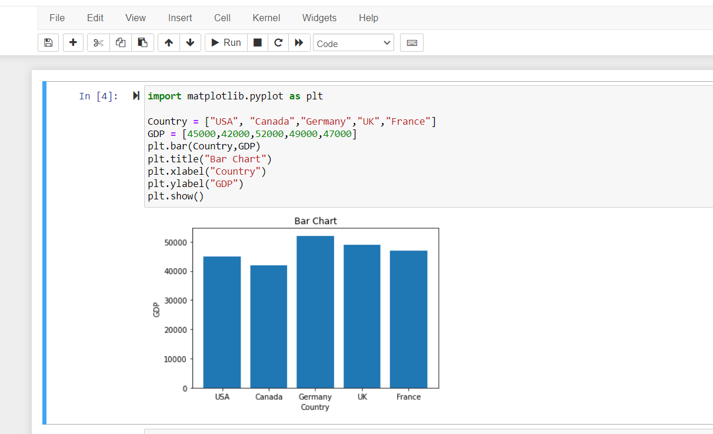
Programmatic Access

Slide 9
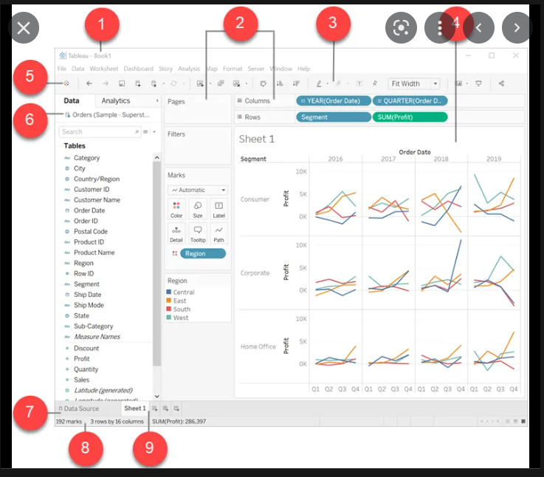
Business Intelligence
Tableau
Power BI

Slide 10
Thank You

